Slide 1
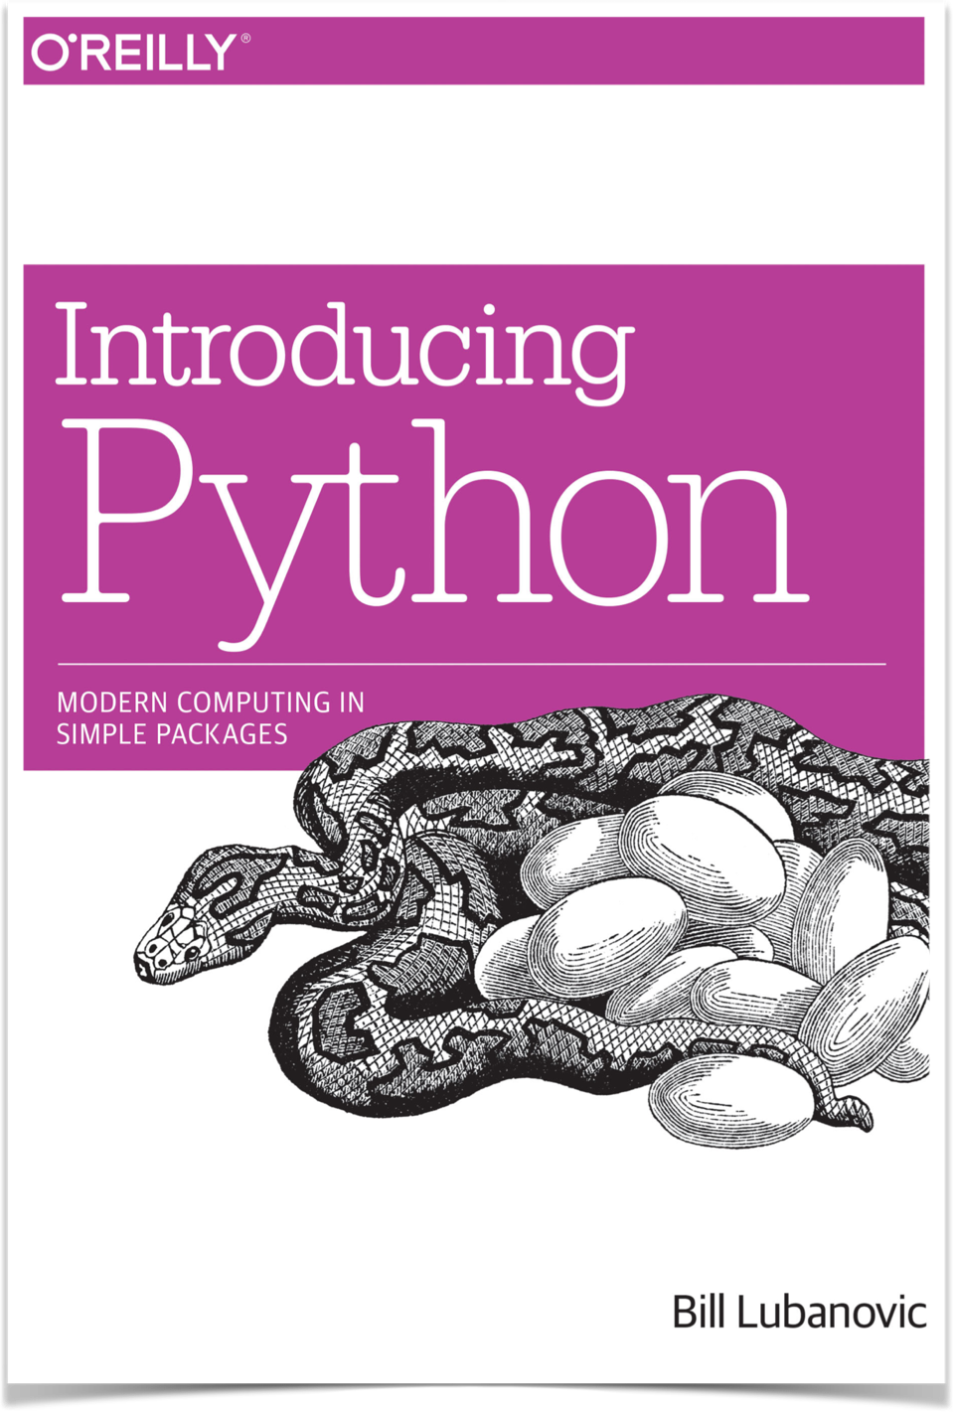
03: Sequences, Types & Dictionaries
Introduction to Data Science Programming
Checking In
Sequences & Other Types
Lists, Ranges, Tuples, Sets (activity 1)
Dictionaries (activity 2)
Mutability & Gotchas (activity 3)

Slide 2
Checking In
How is it going?
What was the hardest part of the homework? The easiest?

Slide 3

Sequences & Other Types
In Python, a sequence is a generic term for objects with an ordered group.
Examples include
lists,
tuples, and
strings.
What are they?
What’s not a sequence?
p
y
t
h
o
n
Notice this string is a sequence,
read starting from the first character.
Any data types without an inherent order, such as
dictionaries,
sets,
ints, and
floats.

Slide 4
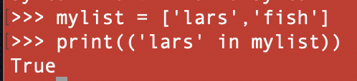
Lists
Sequences share a lot of common methods (but not all). Include or slice with []. The offset starts with 0. E.g., myList = [‘Lars’, ‘Juan’, ‘Pierre’, ‘Marie’, ‘Tan’]
How many elements in the list? len(myList)
I’m looking for “Lars” - is he in the list?
How to add (concatenate) 2 lists?
“‘Lars’ in myList”
a = list()
a.append(“tom”)
a[0] = “tom”
https://docs.python.org/3/tutorial/datastructures.html
https://docs.python.org/3/library/stdtypes.html

Slide 5
Lists
Sequences are helpful! Their methods tell us about the size, min/max values, counts (occurrences) of an object, and more!
myList = [1,2,3,4]
min(myList)
max(myList)
myList = [‘a’, ‘b’, ‘c’, ‘d’]
myList.index(‘x’) # locate the first instance of “x”
myList.count(‘x’) # how many times of “x”
What’s up with the dot? And the parentheses?
Parentheses hold the arguments we’re passing to the function, e.g., len(myList). Not all functions require arguments.
The dot notation indicates that a function is defined in the specific object before the dot.

Slide 6
Lists
While there are better techniques we’ll encounter in NumPy and Pandas, we can imagine using the <list>.index and <list>.count to test for existence of an interesting value and then count them for fitness.

Slide 7
Composites
A list is a composite type - what does that mean?
Other examples?
A composite type comprises other types. Lists, tuples, dictionaries are composite because they can contain other objects. int, float, string are not composites.
E.g., demo = [‘cat’,’dog’,33,[‘j’, ‘k’, ‘l’]]
print(demo[3]) outputs ‘j’,’k’,’l’
0
1
2
3

Slide 8
List Methods
myList.insert(index, value)
myList.pop(x) # pops last value by default but can take instead index argument “x”)
myList.remove() # use remove to eliminate the first instance of a value
myList.sort() # mutate the list - sorting by default in ascending order
sorted(myList) # this returns a new list
myList.reverse() # reverses the list.

Slide 9
List Methods (continued)
myList.append(“x”) # adds “x” to the end of the list
myList.extend(otherList) # adds items from otherList to the end of myList
myList[a] = “z” #swaps out the item at index [a] with whatever z stands for
myList.clear() #clears out the list elements
del(myList[x]) # deletes item from index x

Slide 10

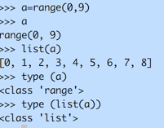


Ranges, Tuples, Sets
Ranges
a sequence
need to be listed to yield the elements
range(start, stop, step)
Tuples
a sequence
like a list but immutable
instantiate: tup_X=(1,2,3) or tup(1,2,3)
Can use a tuple to create multiple objects
Sets
Unordered and mutable
*Unique, keys only

Slide 11

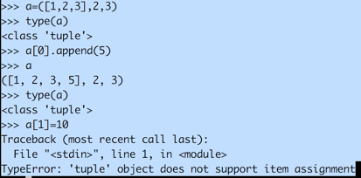
More About Tuples
Tuples are like lists - but they are immutable. What’s happening here?

Slide 12
Activity 1
range(start, stop(exclusive), step)
Practice creating these outputs:
[1, 2, 3, 4, 5, 6, 7, 8, 9]
[0, 1, 2, 3, 4, 5, 6, 7, 8, 9, 10]
[2, 4, 6, 8, 10, 12]
[2, 4, 6, 8, 10, 12, 13, 14, 15, 17, 19, 21]
[-1, 0, 1, 2, 3]
[10, 9, 8, 7, 6, 5, 4, 3, 2, 1]

Slide 13
Dictionaries
Instantiation (many ways)
dict_x = {‘fred’:1, ‘frank’:3, ‘ben’:1}
As a dict literal
dict_x = dict([(‘fred’,1),(‘frank’,3),(‘ben’,1)])
As a list of tuples
Index by key to get value
dict_x[‘fred’]
# indexing by key name

Slide 14
Dictionary Methods
del(dict_x[‘key’])
dict_x.pop(‘key’,’default value’)
dict_x.get(‘key’,’default value’)
dict_x.clear()
dict_x.update(dict2)
dict_x.keys()
dict_x.values()
dict_x.items()
# delete by key reference
# pop the value for key from dictionary. If the key doesn’t exist, the function will return the default
# appends a second diction to the first
# get the key:value pairs

Slide 15
Sample .json structures
{ people
[name, tom]
[name, fifi]
}
{"menu":
{ "id": "file",
"value": "File",
"popup":
{ "menuitem": [
{"value": "New",
"onclick": "CreateNewDoc()”
},
{ "value": "Open",
"onclick": "OpenDoc()”
},
{ "value": "Close",
"onclick": "CloseDoc()”
} ]
}
}
}
Just a note in passing …
JavaScript Object Notation (.json) files are used a lot to share data.
Notice that GitHub files (in “raw”) mode show the underlying .json that’s converted to a useful tool in Jupyter.
https://json.org/example.html

Slide 16
Activity 2 - Dictionaries
Mutable, what does that imply?
Not a sequence, what does that mean?
Maps keys to values # aka: map, key:value store
a = {‘fred’:1, ‘frank’:3, ‘ben’:1}
book = {‘changjing’:’555-1212’, ‘jim’:’333-234’}
a = {‘names’: {‘fred’:404, ‘frank’:3, ‘ben’:1}} # can be nested (JSON)
Values can be any type
Keys need to be hashable # should be immutable
Python uses a hash function to quickly locate items stored in a dictionary. The key, when passed through the hash function, points to a unique place in the computer’s memory. This makes finding the value extremely fast. Keys cannot be mutable, since if they were, the hash function would not return the same result.

Slide 17
Mutability
Mutability: a list is mutable, meaning we can change the length and content. E.g.,
alist = []
aList.append(‘cat’)
bList = [‘a’,’b’,’c’]
aList.extend(bList)
print(aList)
[‘cat’,‘a’,‘b’,‘c’]
Which data types are mutable? Immutable?
Mutability means the object can be changed;
dictionaries, lists, and sets are mutable;
tuples and strings are immutable.
Primitive data types such as ints and floats are also immutable.

Slide 18

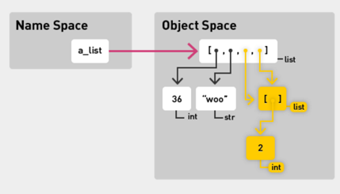
Mutability Gotchas
Note, items 3 and 4 are the same object: [36, “woo”, [2], [2] ]

Slide 19

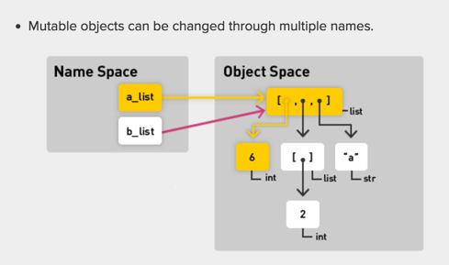
Mutability Gotchas (con’t)

Slide 20

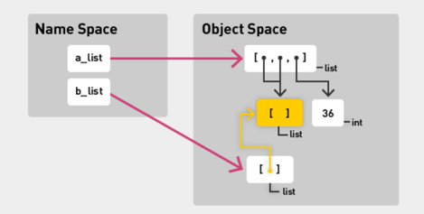
Mutability Gotchas (con’t)

Slide 21
Copy & Deepcopy
Consider this snippet:
Ls_x = [ 1, 2, 3, [‘Frank’, ‘Fred’]] Ls_x_cp = Ls_x.copy()
from copy import deepcopy
Ls_x_deep = deepcopy(Ls_x) Ls_x[3][1] = ‘Mufasa’

Slide 22
Copy & Deepcopy (con’t)
What is copy?
Copy creates an independent copy of all list elements at the first level of the list.
How does copy differ from deepcopy?
Deepcopy creates an independent copy of all list elements at all levels.
What is the final value of Ls_x_cp and Ls_x_deep?
Lx_x_cp is [1,2,3,[‘Frank’,’Mufasa’]
Lx_x_deep is [1,2,3,[‘Frank’,’Fred’]

Slide 23
List & Dictionary Activity
We are now going to solve a very popular problem: How do you count the words in a document?
While the solution here is simple, you will see in later courses that this is an excellent first problem when learning how to massively parallelize your code across a cluster of computers.
The activity will guide you to the solution in a series of steps.
As you will see next week, the “while” loop in this activity could be better represented by a “for” loop. For now, please work with the “while” loop.

Slide 24
Activity 3 - Mutability
Mutability Activity:
Read about and update a scoreboard reporting ranking and team color of contestants.
Your job? Programmatically change the scoreboard as indicated. Hint! Use copy and/or deepcopy if required.
Contestants = [{“name”;”fred”, “teamColor”:”Red”},
{“name”:”Layla”, “teamColor”:”Yellow”},
{“name”:”Tammy”, “teamColor”:”Green”},
{“name”:”Buba”, “teamColor”:”Blue”}]

Slide 25
That’s It
Remember that scores & comments are listed in ISVC site.
If you want to redo assignment 1, go ahead.
Home works are very important - communicate with each other, with the instructors, etc. If you’re spending too much time, step away and rest … then tackle with fresh eyes.
At this point in our studies we might slog thru some code … There is almost always a more efficient way of doing things and we’re going to encounter many of them in the coming weeks.

